Slide 1
Control Board to Diaphragm Pump Cable

Slide 2
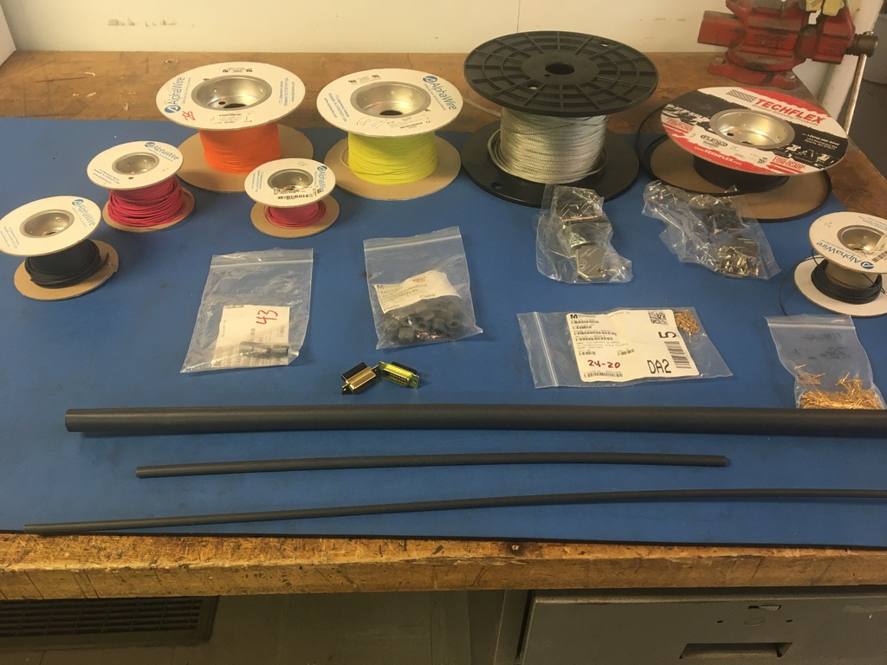
Materials

Slide 3
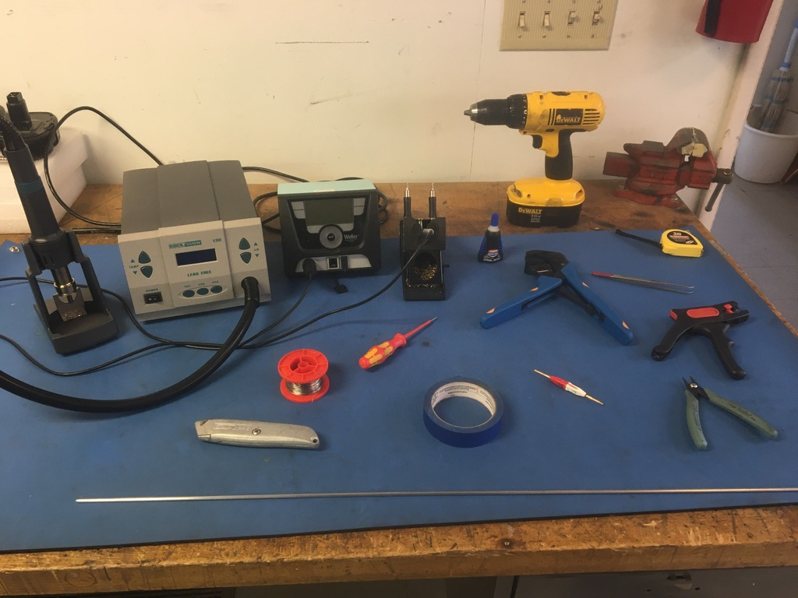
Tools

Slide 4
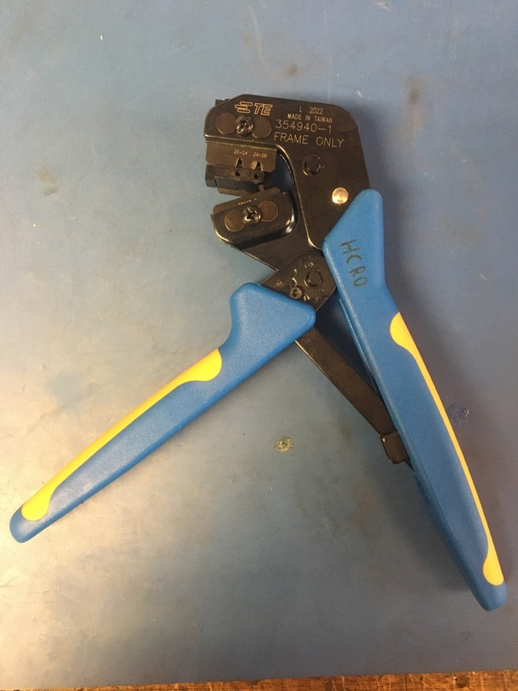
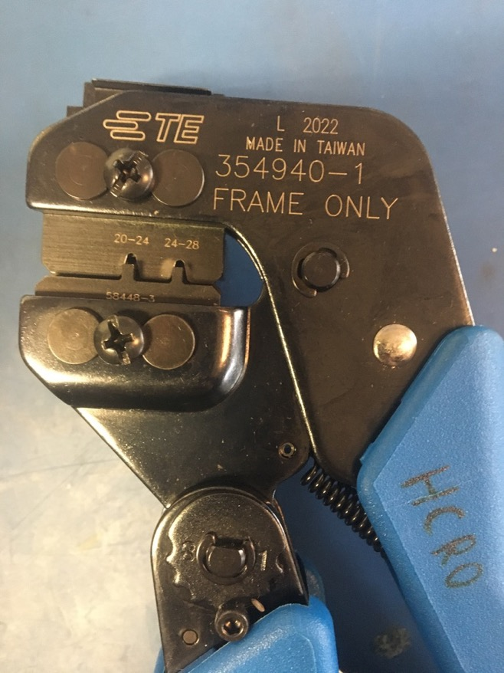
D sub Crimp Tool

Slide 5
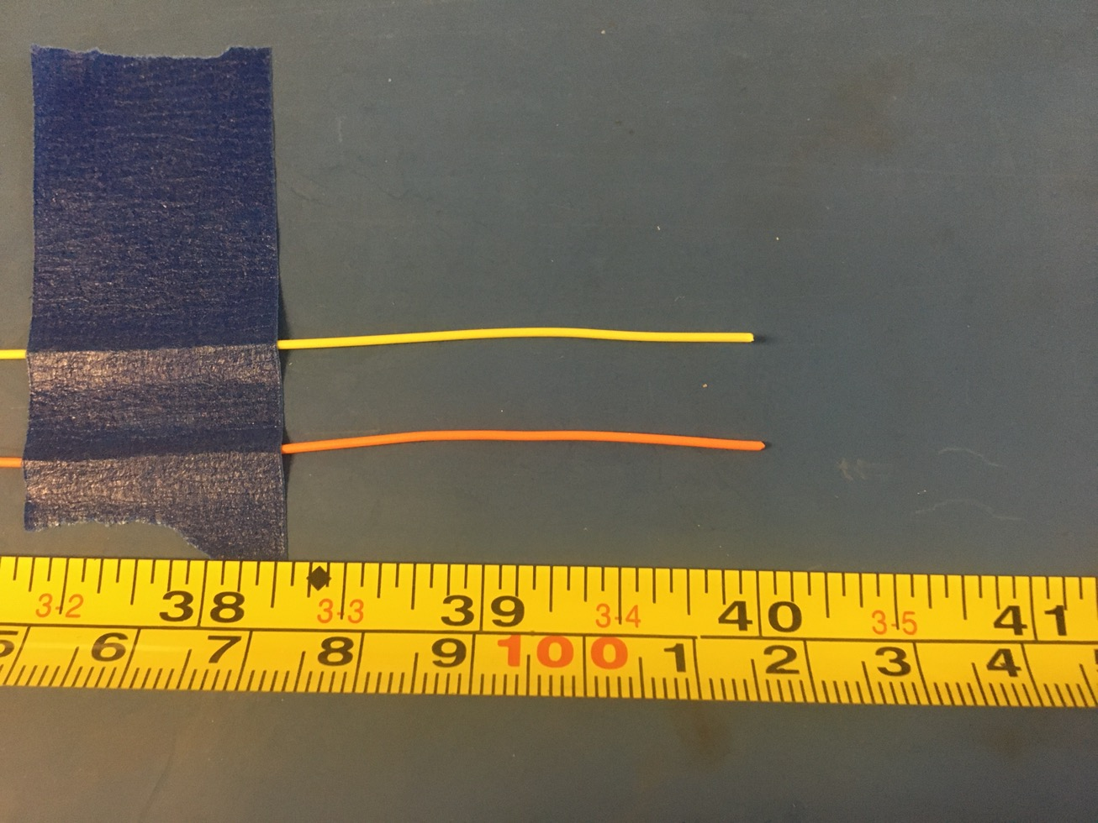
Measure out and cut 40 inches of yellow and orange 28 awg wire as well as black and red 20 awg wire.

Slide 6
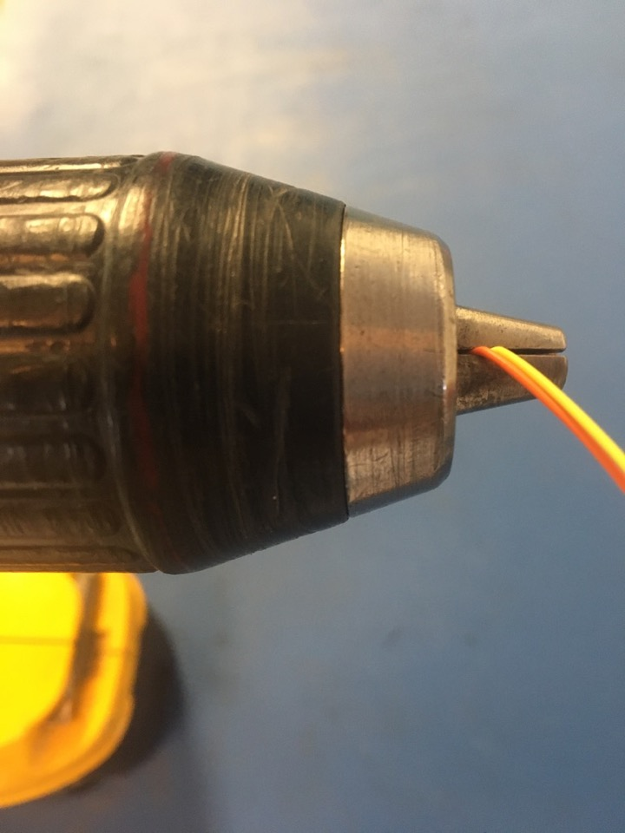
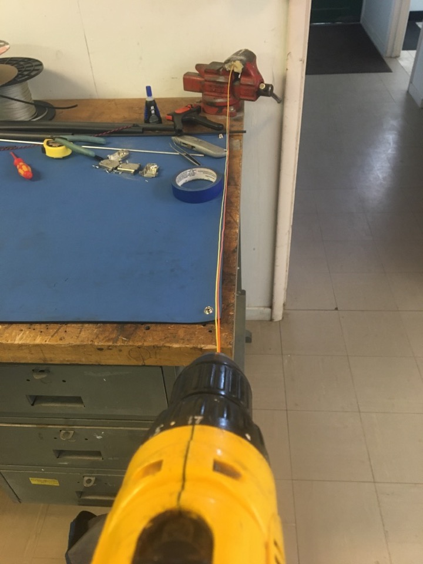
To make the twisted pairs, line the vise with masking tape. Put one end of the yellow and orange wires into the vise and the other into the drill. Run the drill till the wires are sufficiently twisted (for reference see the next slide). Repeat with the black and red wires.

Slide 7
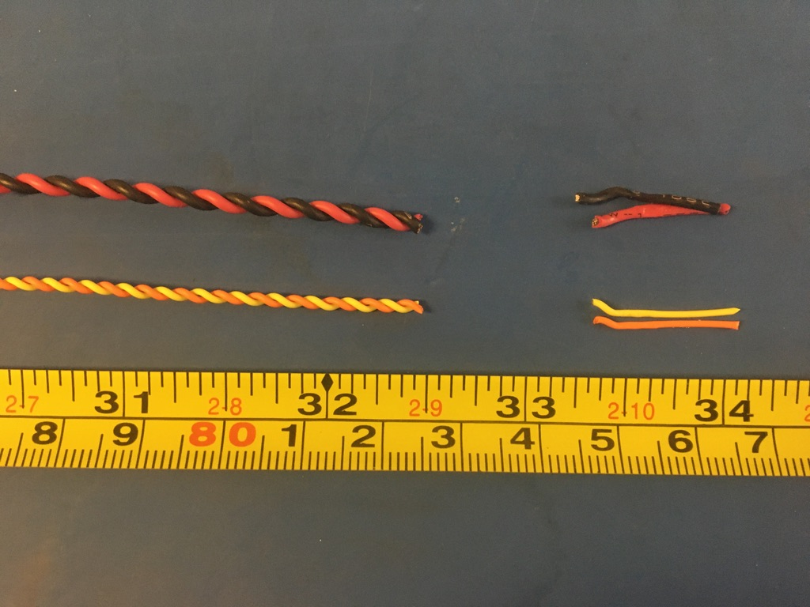
Trim the ends of each twisted pairs where they were in the vise and drill. Once trimmed they should measure about 32.5 inches.

Slide 8
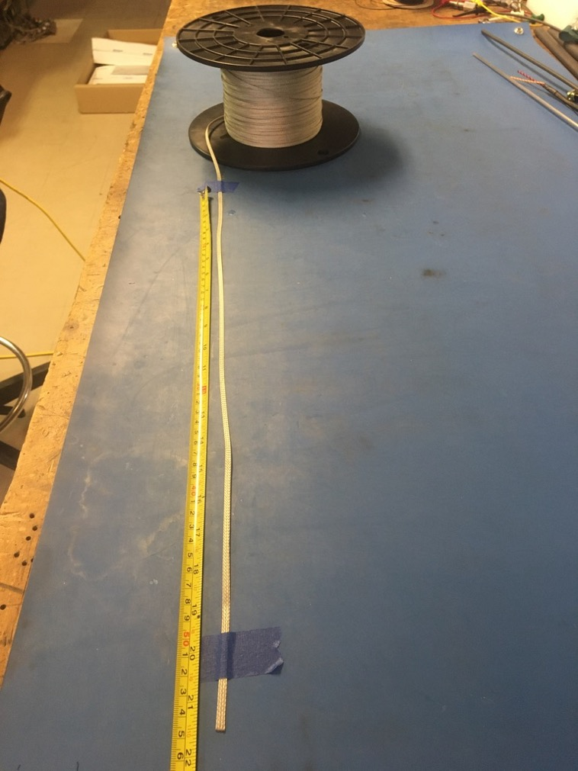
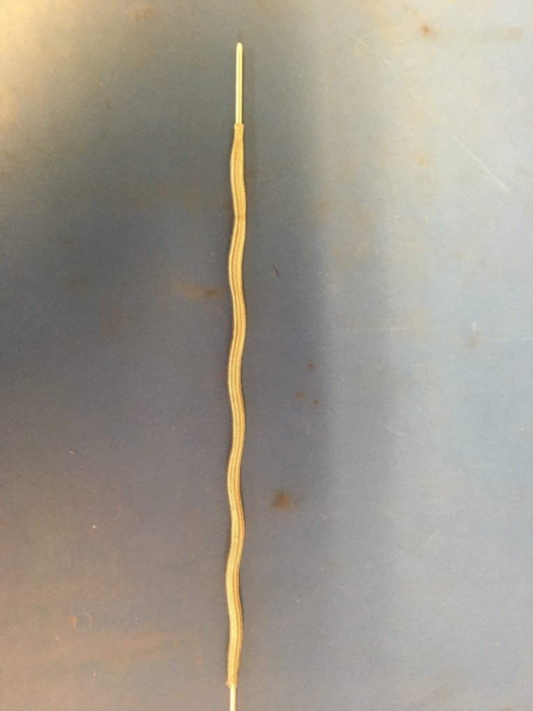
Measure out 21.5 inches of the 1/8th metal braid. Expand it using the metal rod.

Slide 9
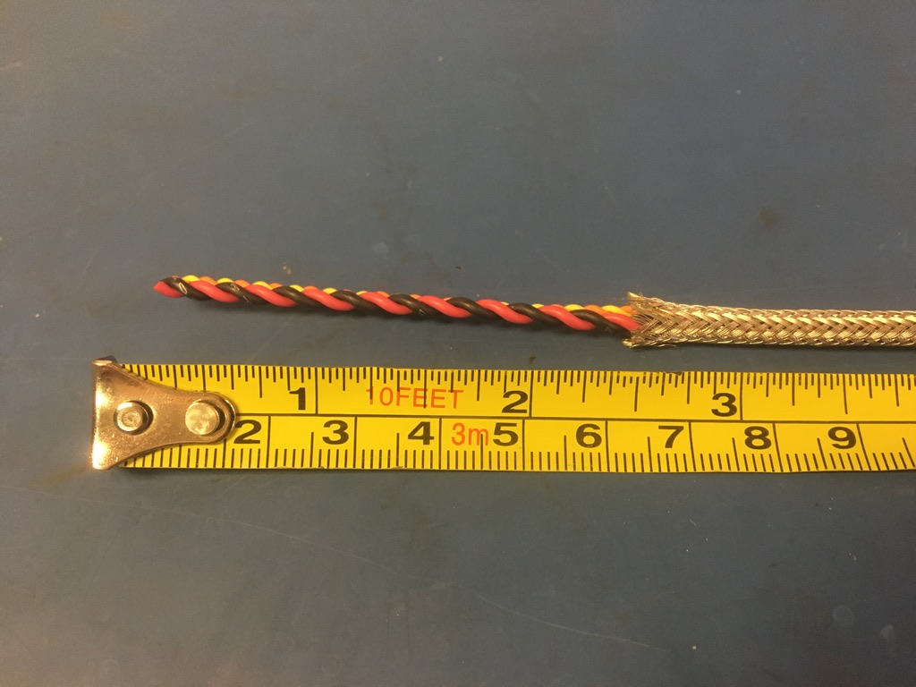
Put the twisted wires into the expanded metal braid. 2.5 inches of the twisted wires should stick out from the metal braid on one end.

Slide 10
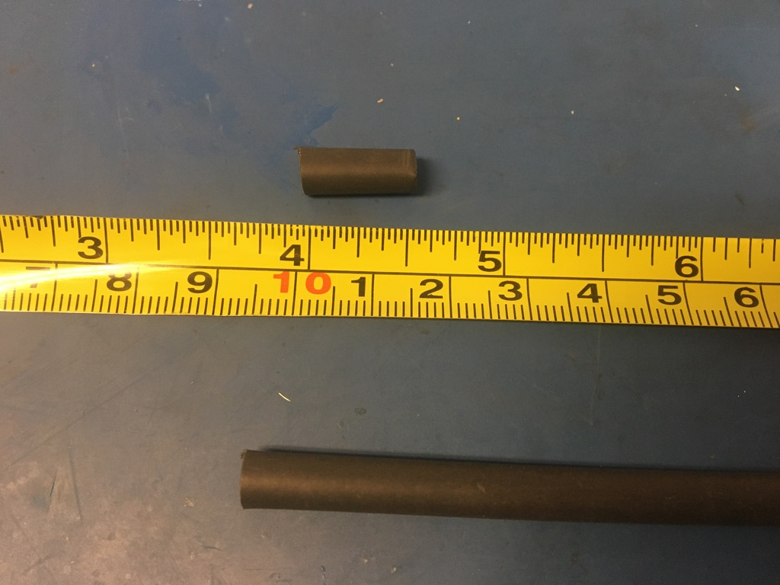
Measure out and cut two lengths of 4.8mm adhesive shrink tube each .5in long.

Slide 11
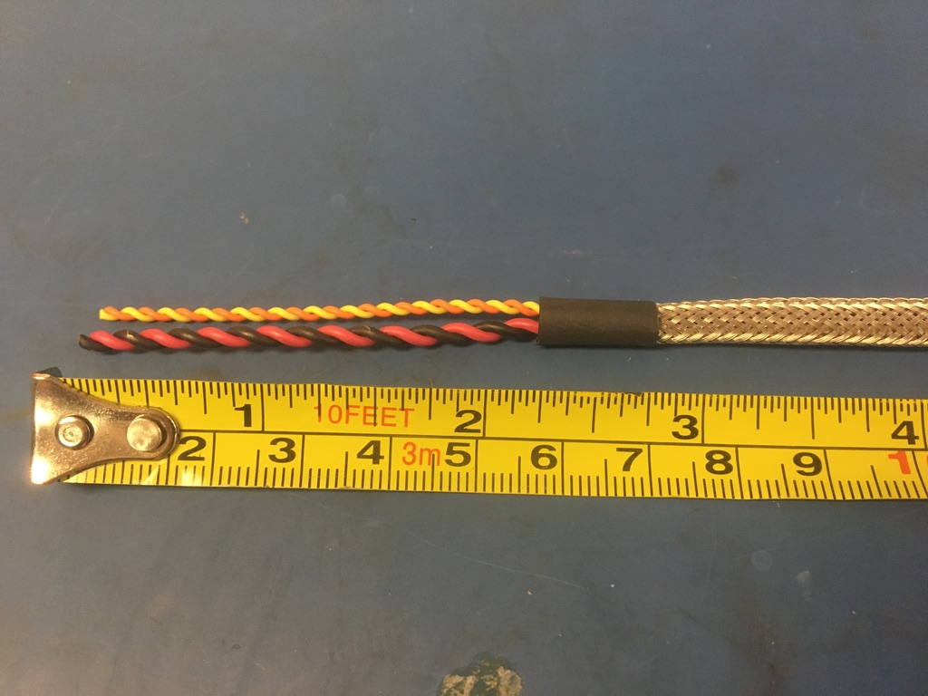
Put one of the pieces of the shrink tube onto the end of the metal braid where the wires measured 2.5 inches. Place the shrink tube such that the metal braid ends midway through it. The wires should now measure 2.25 inches long. Apply the heat gun to the shrink tube.

Slide 12
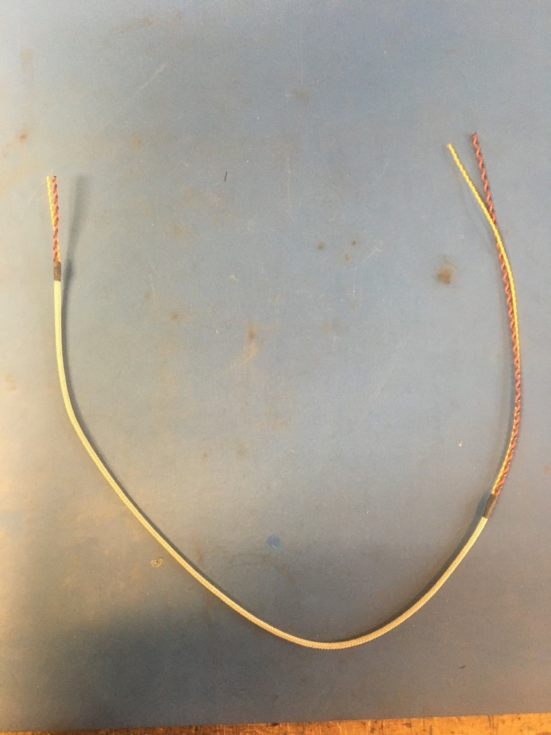
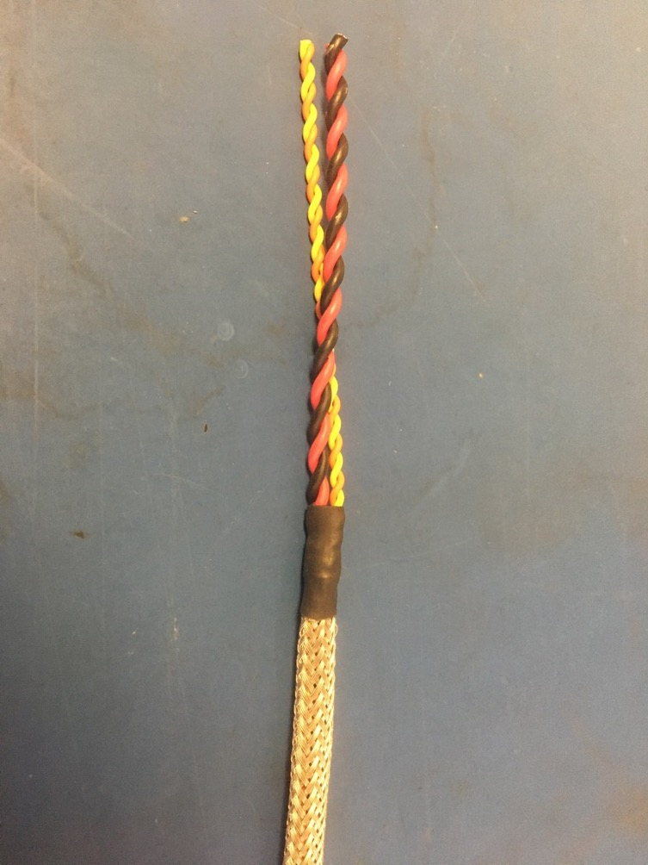
Repeat the process on the previous slide on the other end of the metal braid (though the wire does not need to be measured this time). Thus far, the wire harness should appear as shown on the right.

Slide 13
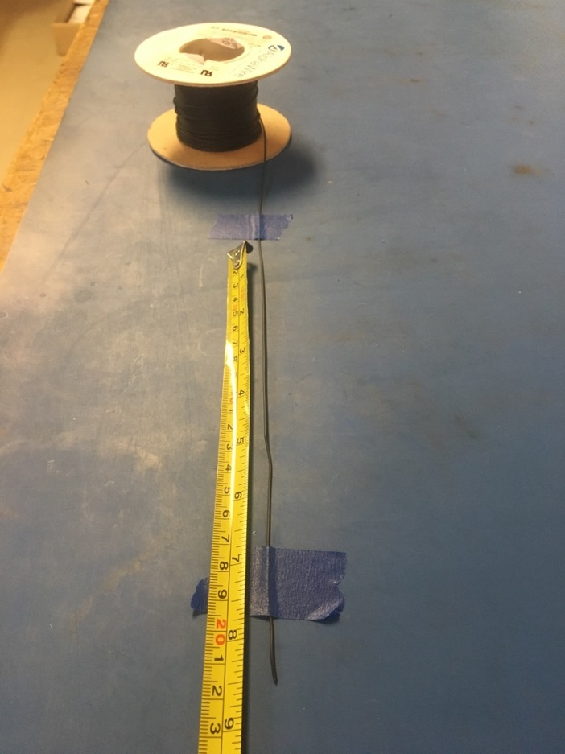
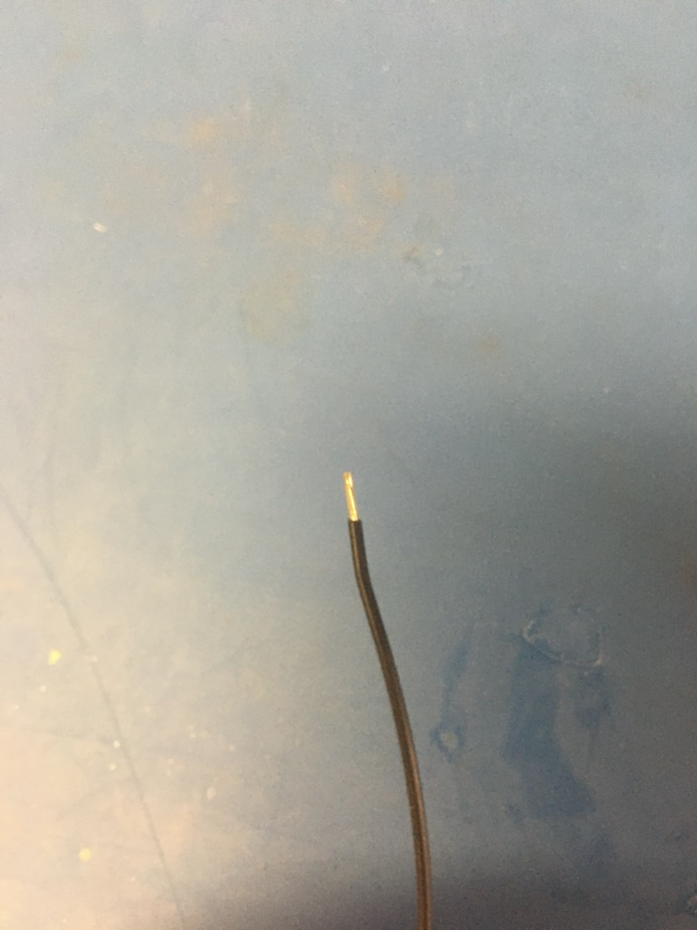
Measure out and cut 8.5 inches of black 24 awg wires. Strip 3-4mm off one end.

Slide 14
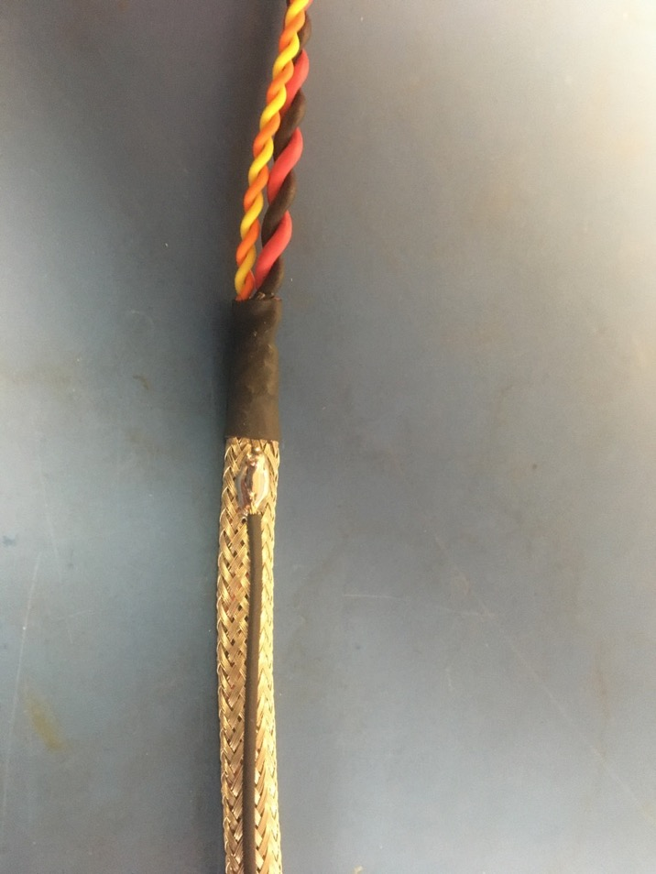
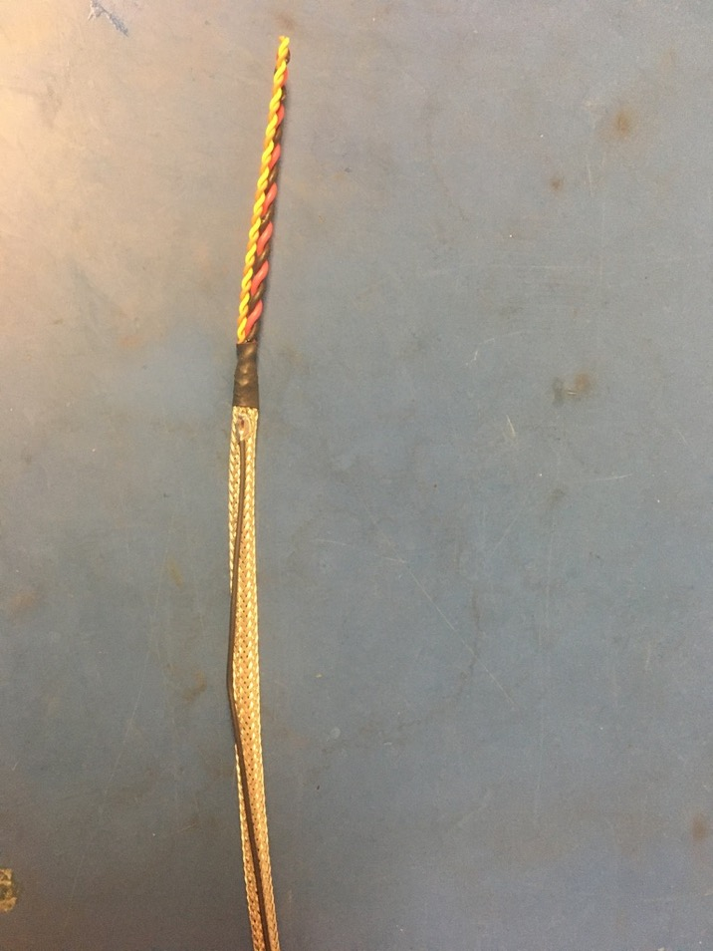
Solder the stripped end of the black wire onto the metal braid near the shrink tube joint with the shorter length of wire (the end that was measured to be 2.25 inches). The black wire should be soldered so the that its length runs with that of the metal braid.

Slide 15
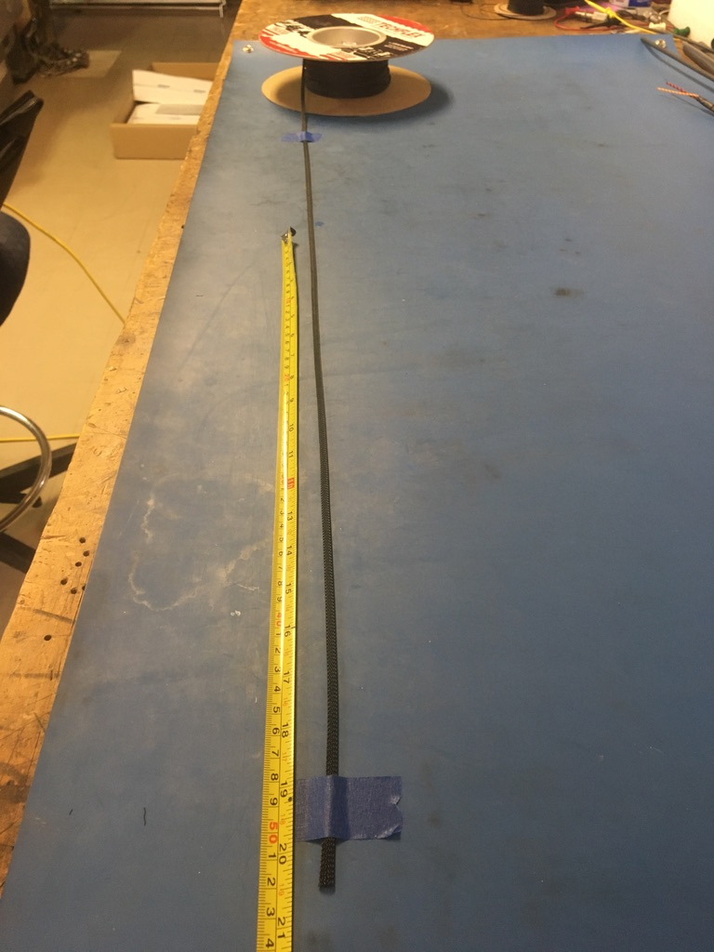
Measure out and cut 20.5 inches of 1/4th plastic braid.

Slide 16
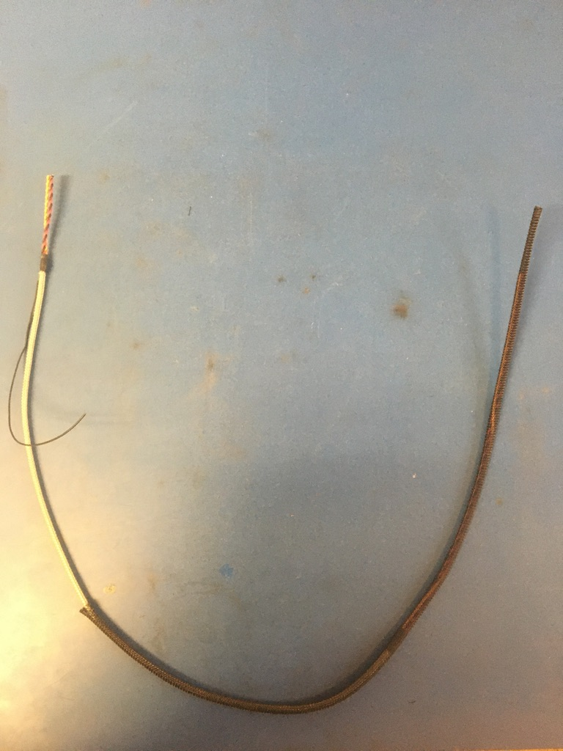
Put the plastic braid onto the wire harness. It does not matter from which end.

Slide 17
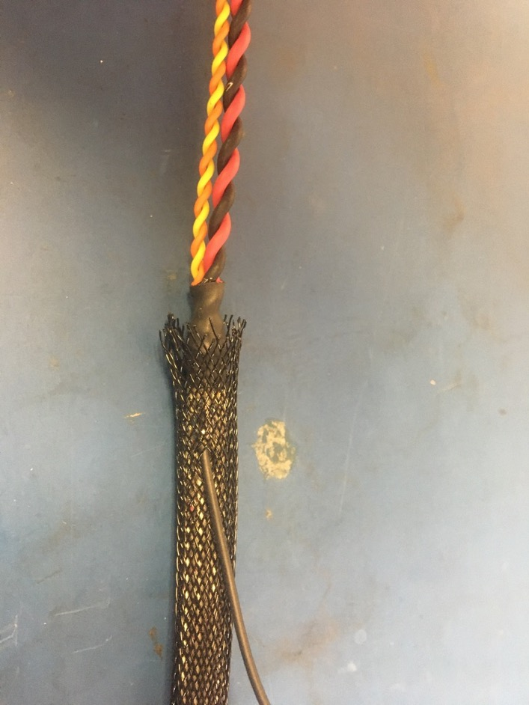
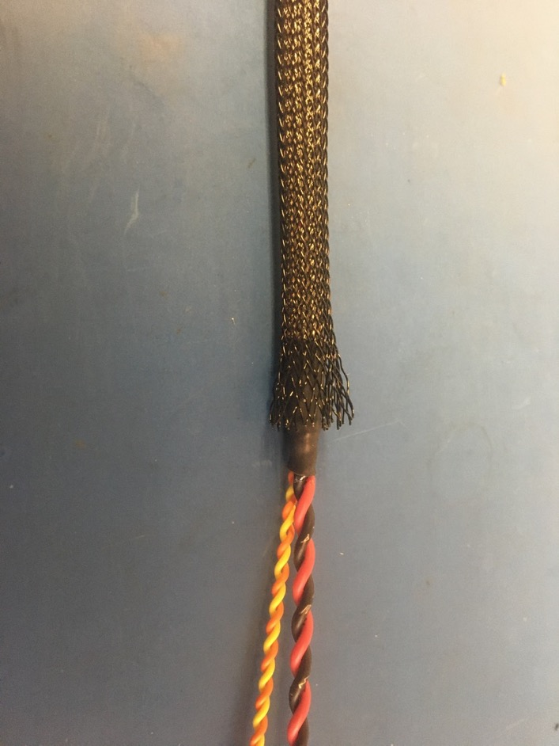
Thread the ground wire through one of the holes in the plastic braid so it appears as shown of the left. At each end of the harness, the plastic braid should end midway through the metal shrink tube joints.

Slide 18
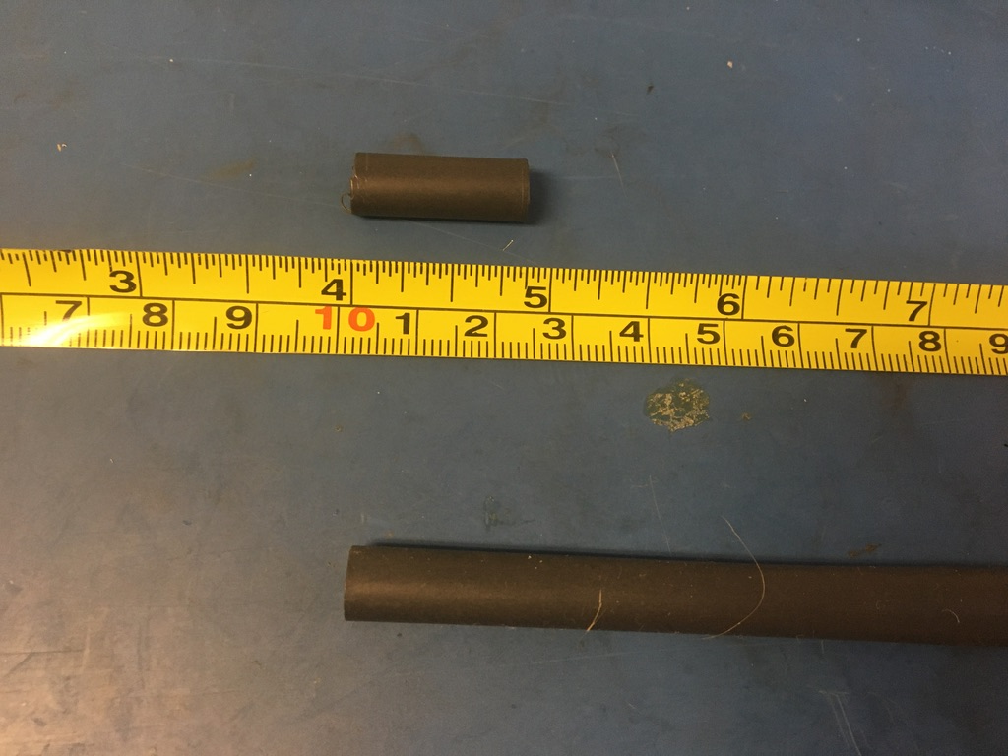
Measure out and cut one length of 6.4mm adhesive shrink tube that is 1in long.

Slide 19
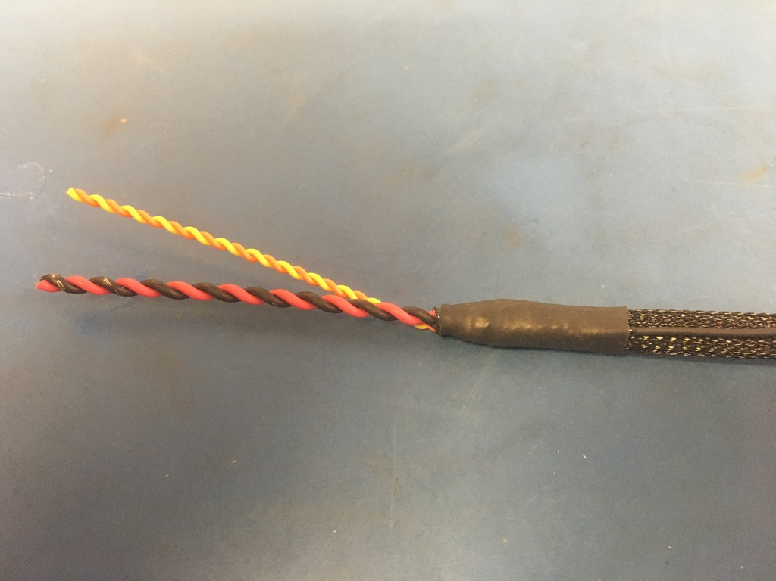
Place the piece of shrink tube onto the ground wire end of the harness. The shrink tube should be placed such that it covers the solder joint and the length of the metal braid shrink tube. Apply the heat gun.

Slide 20
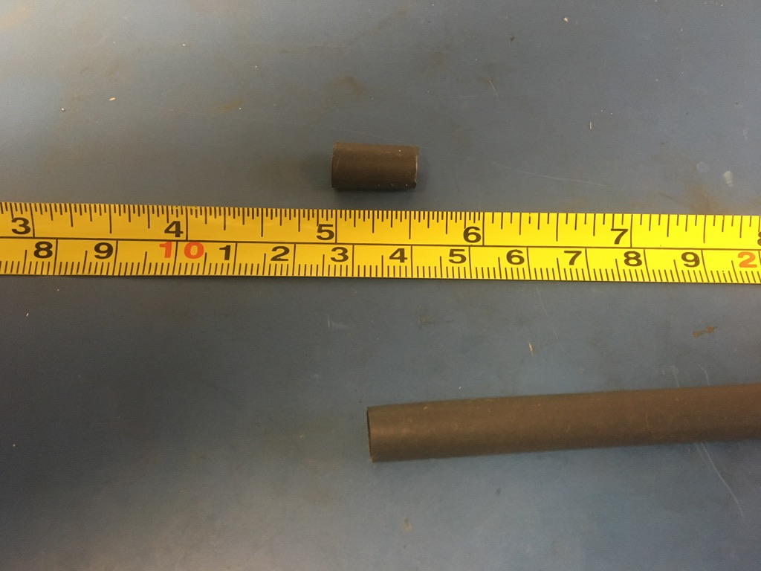
Measure out and cut one length of 6.4mm adhesive shrink tube that is .5in long.

Slide 21
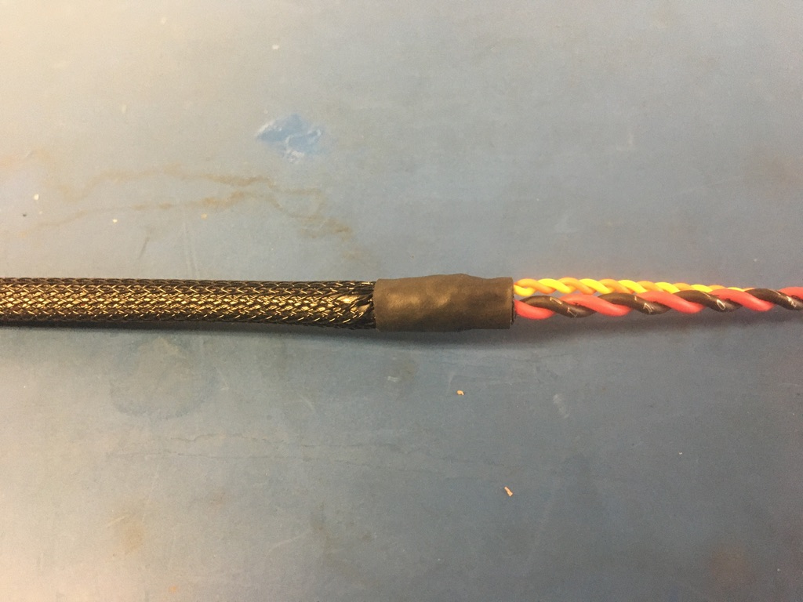
Place the piece of shrink tube onto the plastic braid end without the ground wire. The plastic braid should end midway through the piece of shrink tube. Apply the heat gun.

Slide 22
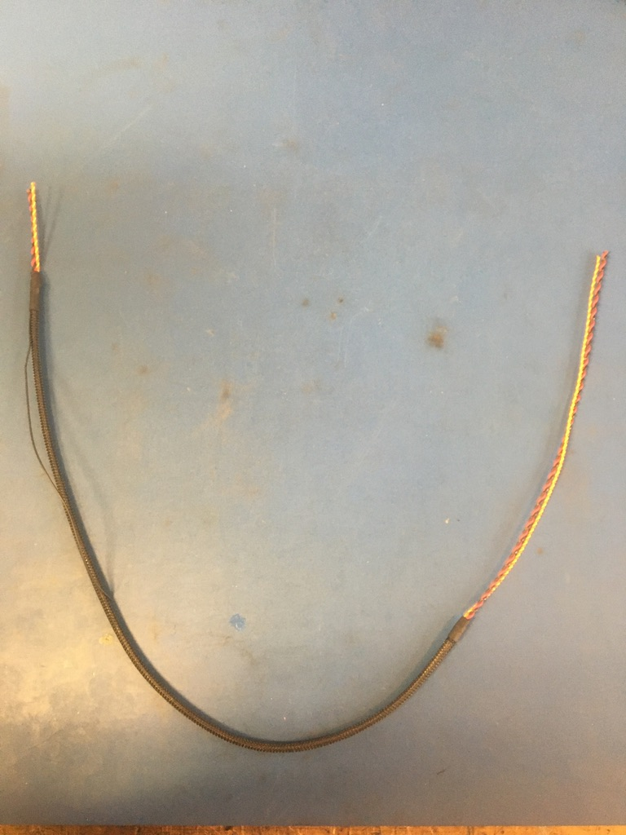
So far the wire harness should appear as shown on the left.

Slide 23
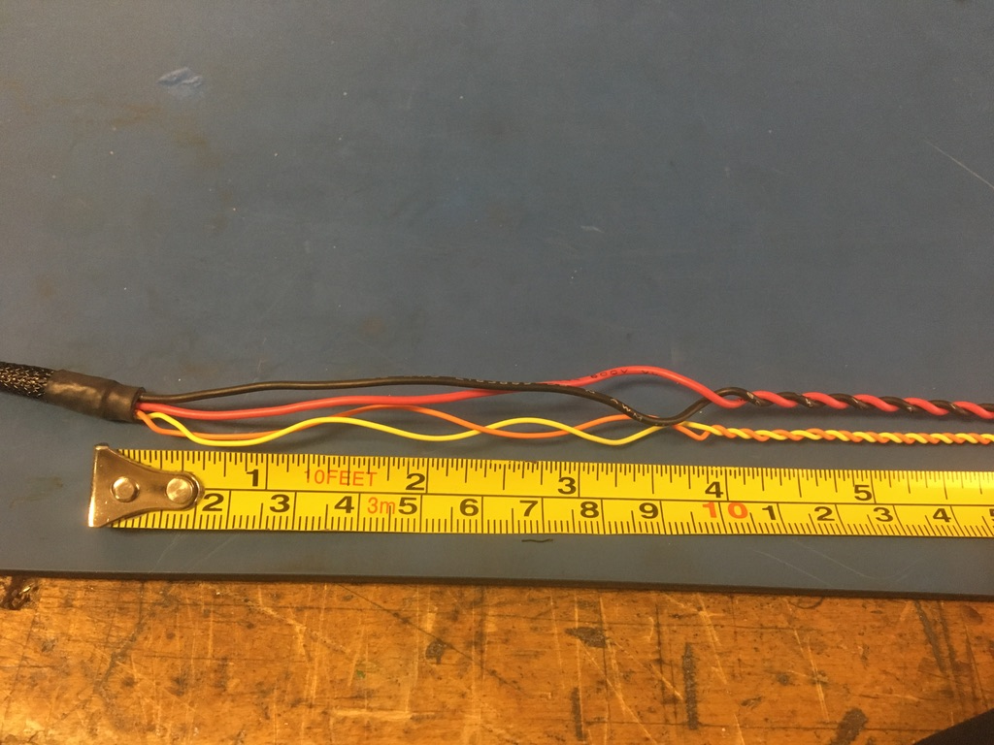
Take the end of the harness without the ground wire and untwist about 4in of the twisted pairs.

Slide 24
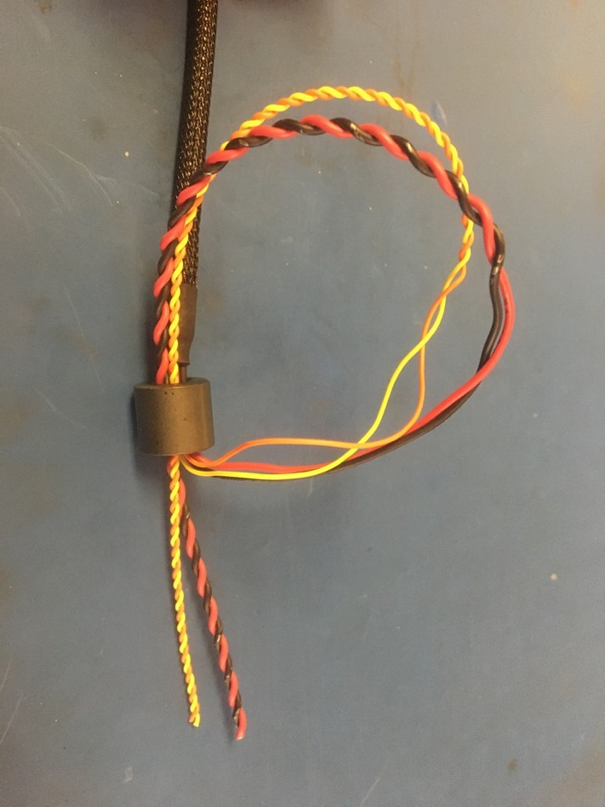
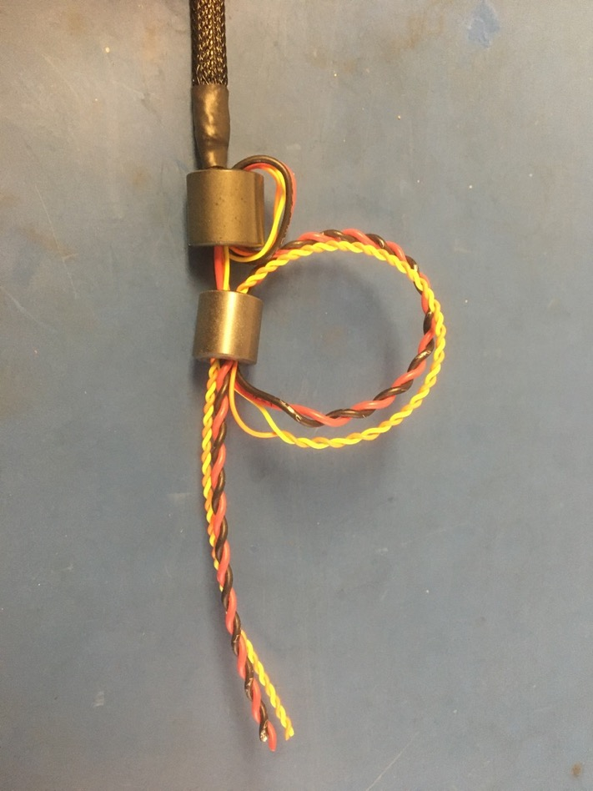
Thread the 75 magnet onto the end of the harness that was just untwisted. Then thread the wires back through the bottom of the magnet as shown on the left. Pull the loop of wire taught so the 75 magnet appears as shown on the right. Repeat this process with the 43 magnet. It may be necessary to untwist more wire for the 43 magnet.

Slide 25
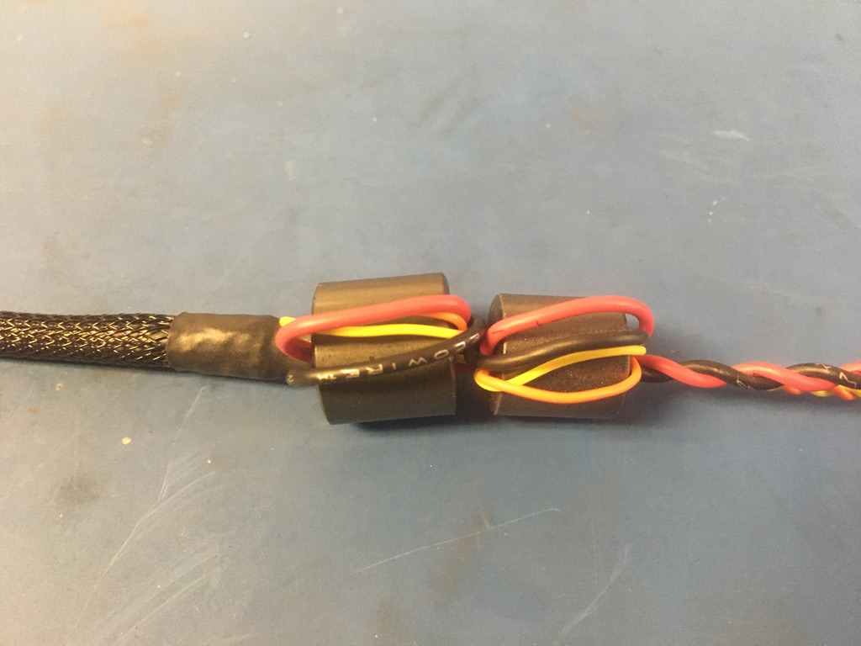
Once both magnets are on the wire harness, they should appear as shown.

Slide 26
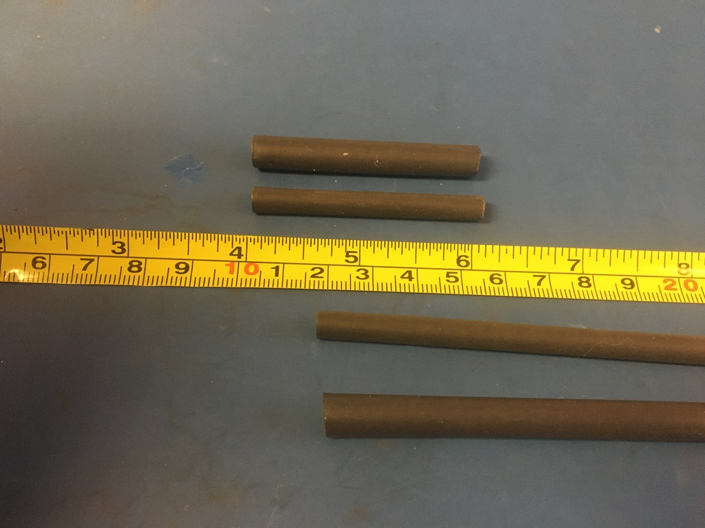
Measure out and cut 2in long lengths of 4.8mm and 6.4mm adhesive shrink.

Slide 27
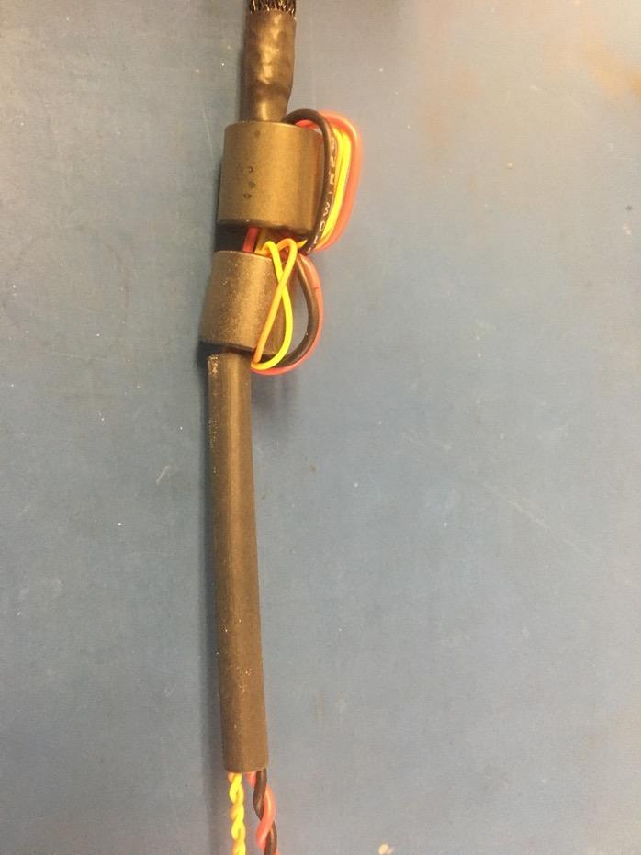
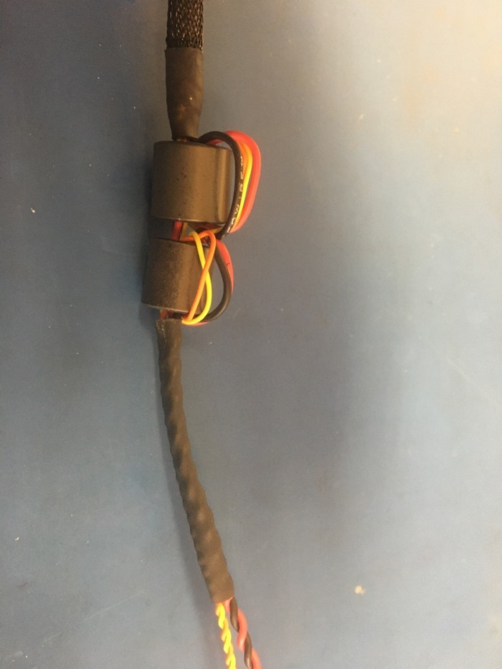
Place the 4.8mm piece of shrink tube onto the wire harness such that it abuts the magnets. Apply the heat gun.

Slide 28
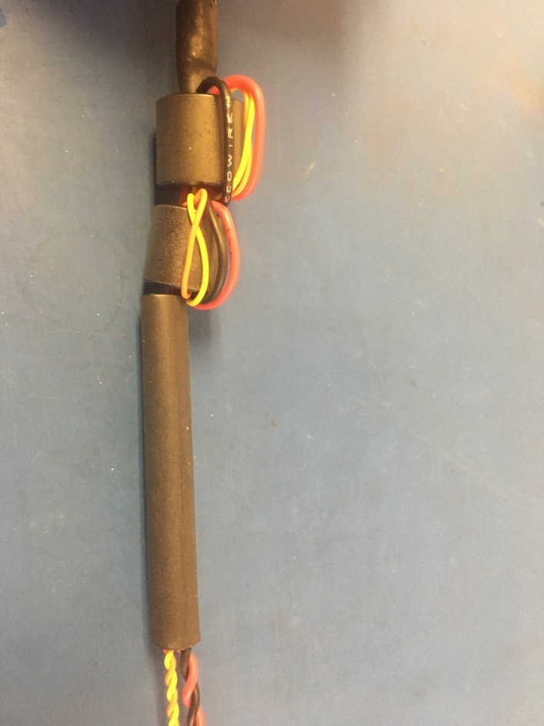
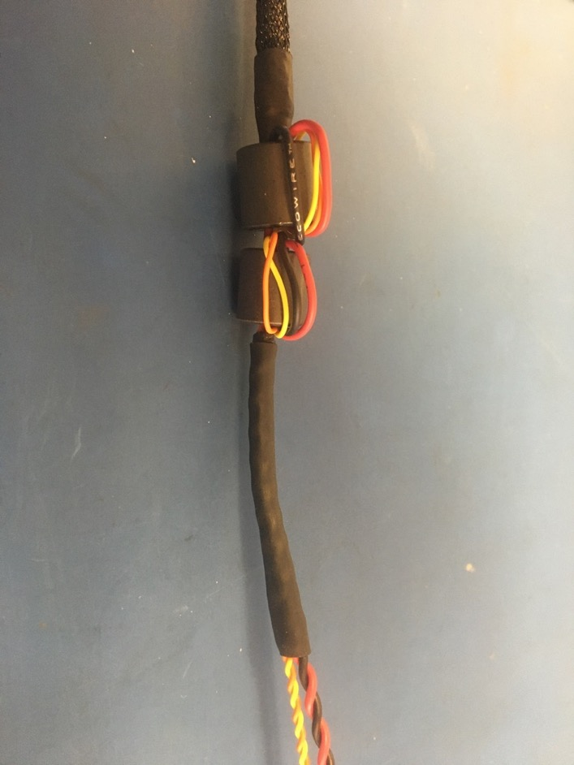
Place the 6.4mm piece of shrink tube onto the wire harness such that it layers atop the 4.8mm piece. Apply the heat gun.

Slide 29
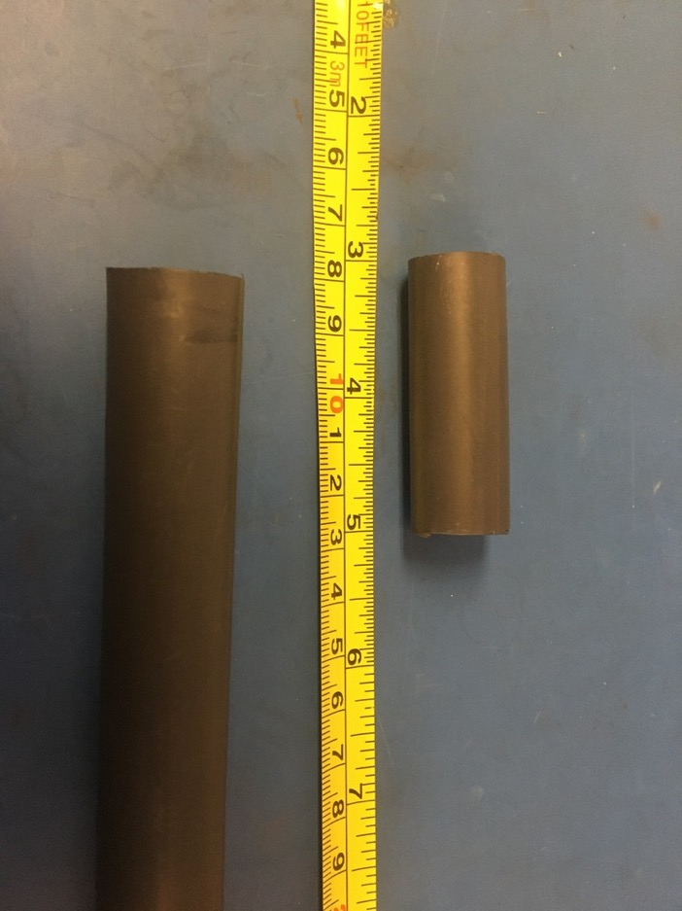
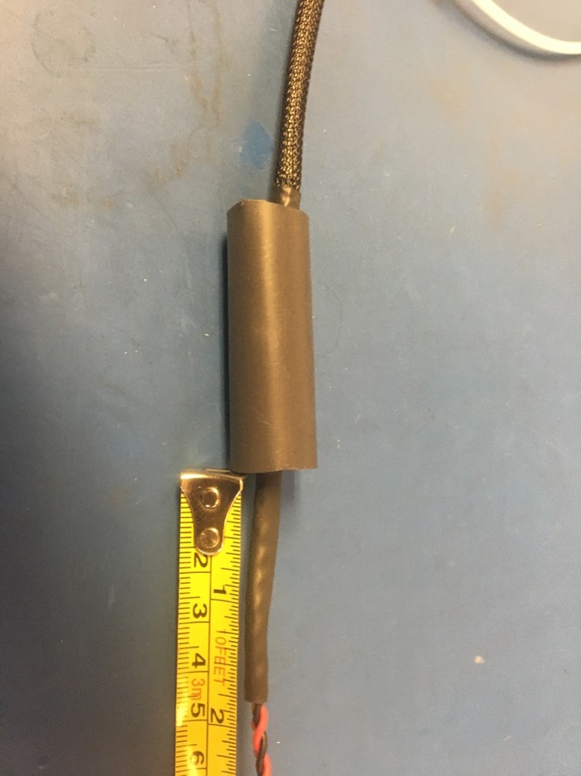
Measure out and cut one length of 16mm adhesive shrink tube that is 2in long. Place the piece of 16mm shrink tube over the magnets and far enough down so that 1.75 inches of the shrink tube applied on the previous slide is visible as shown on the right.

Slide 30
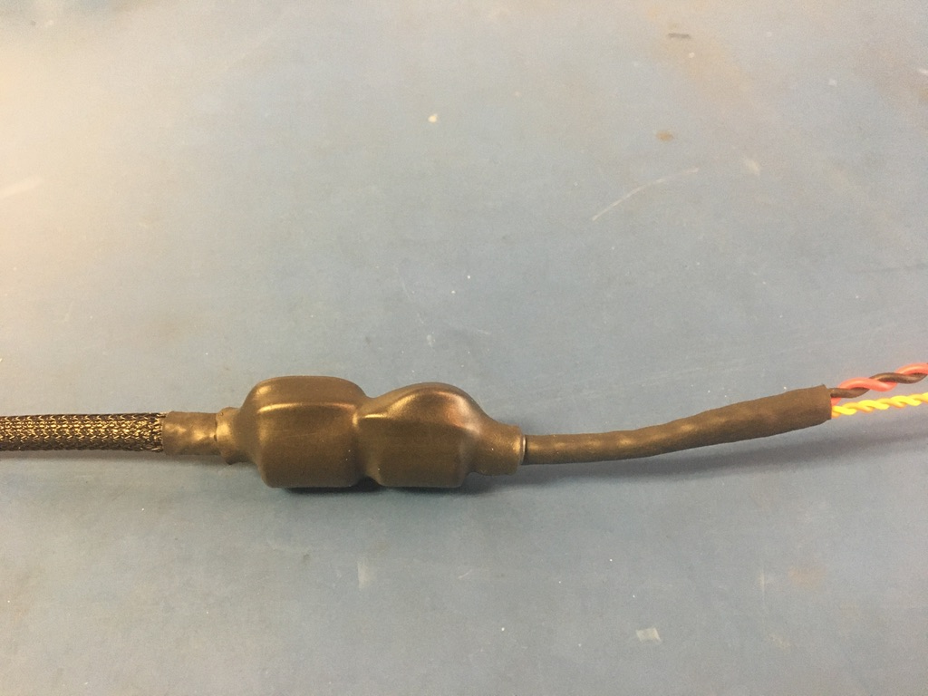
Apply the heat gun.

Slide 31
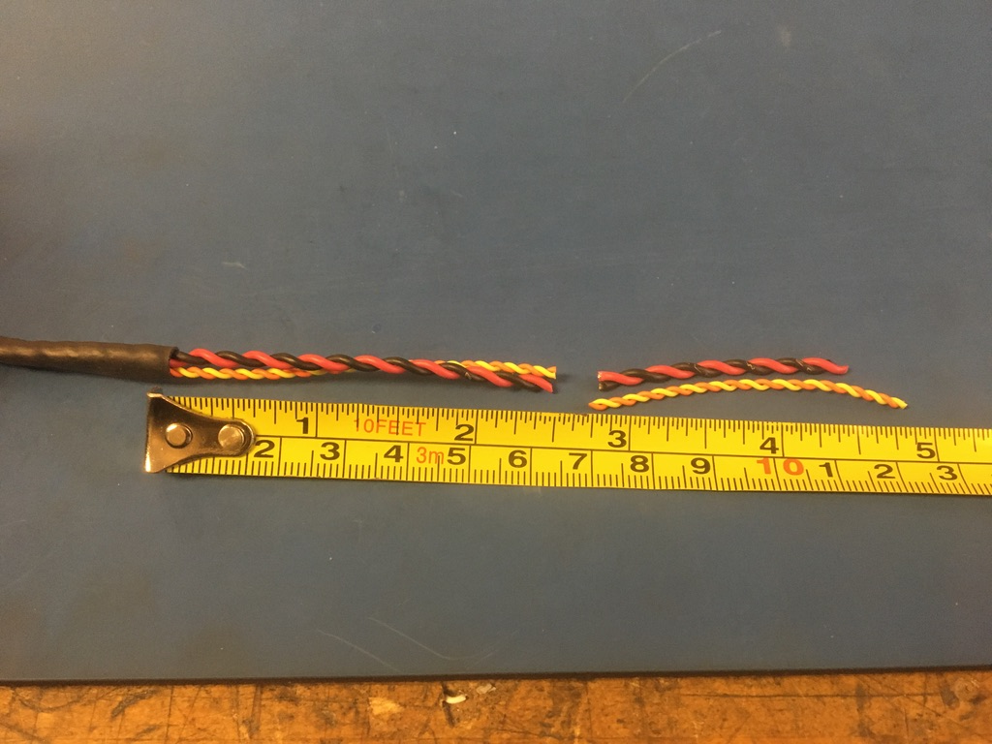
Measure and cut the twisted pairs on the magnet end of the harness so that they measure 2.5 inches.

Slide 32
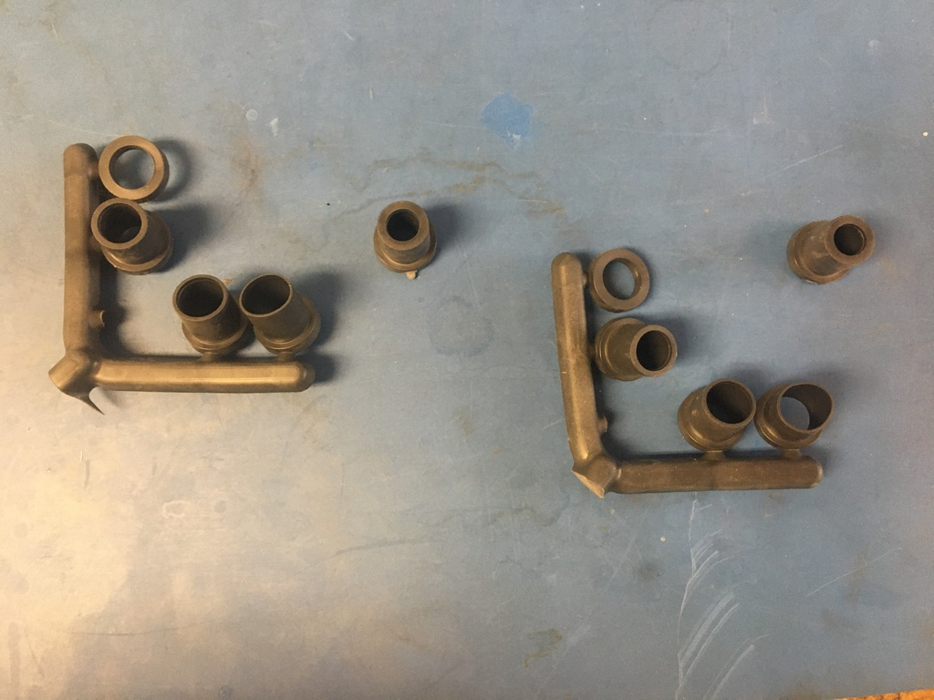
Select the D-sub shell stops. If using new D-sub shells, the smallest size is appropriate. However, if reusing old D-sub shells, use the smallest size available. Test the D-sub shell stops on each end of the wire harness. If the fit is loose, layer shrink tube until the fit is more snug.

Slide 33
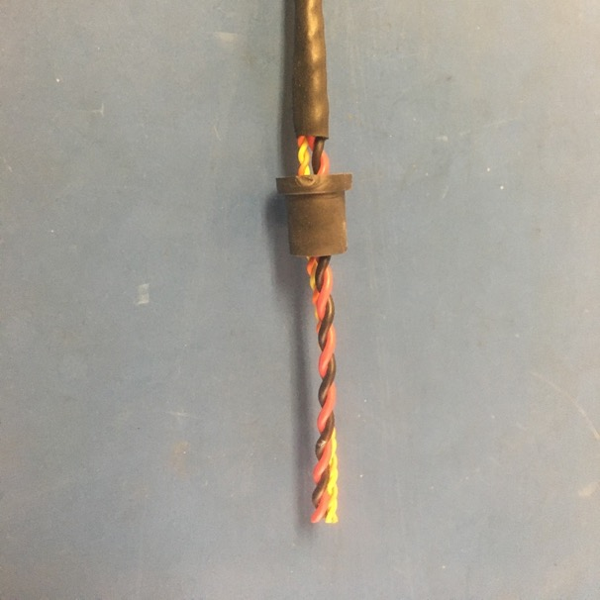
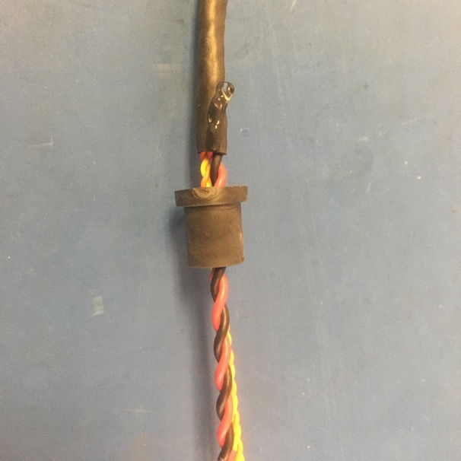
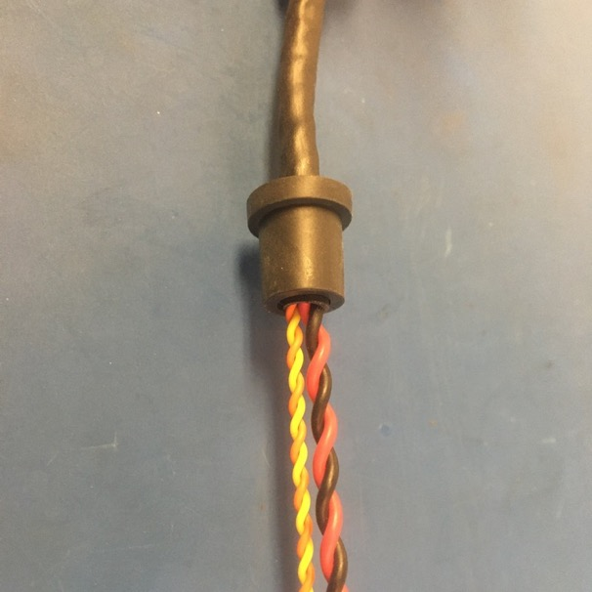
Once any additional shrink tube is added, thread the D-sub shell stop onto the magnet end of the harness and apply super glue to the end of the shrink tube as shown. Put the D-sub shell stop over the super glue and twist it around to spread the super glue inside the stop. The final position of the D-sub shell stop is as shown on the right: with the stop’s end flush with that of the shrink tube.

Slide 34
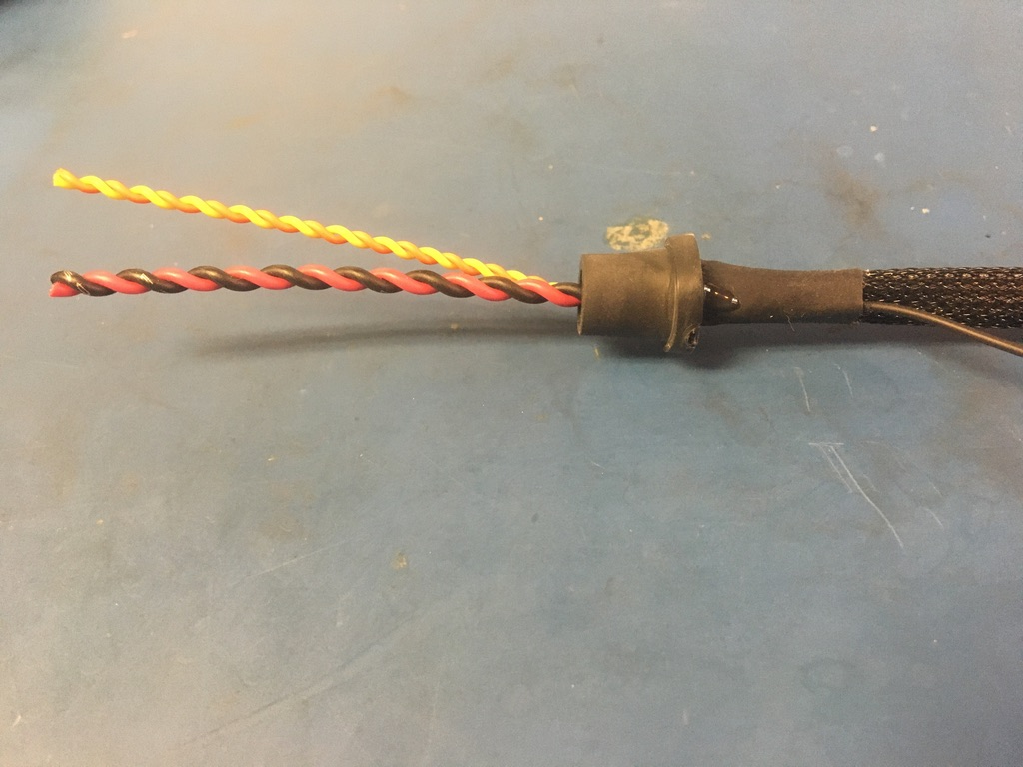
Repeat the process shown on the previous slide on the ground wire end. It’s recommended that the super glue be allowed to dry before continuing as it is easy to get on one’s hands.

Slide 35
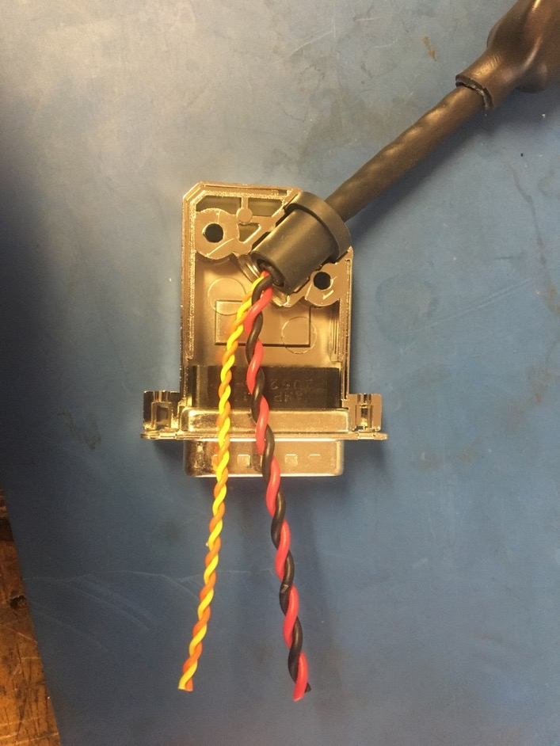
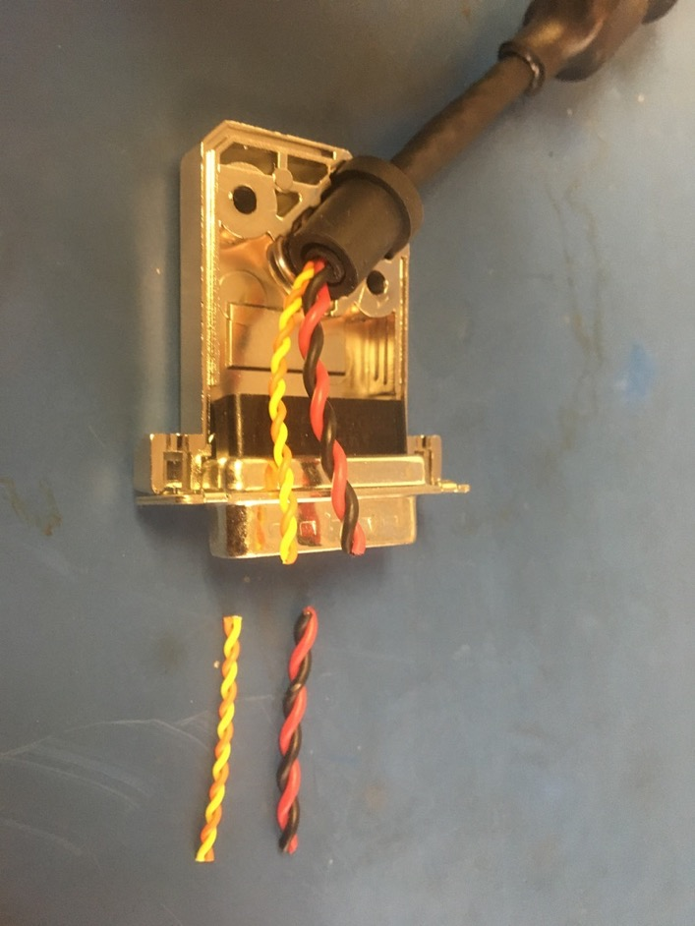
Taking the magnet end of the harness, place the D-sub shell stop into the bottom of the D-sub shell as shown. Put the 15 pin male D-sub connector into the bottom of the shell as well. Measure out and cut the twisted pairs so that they end at the mouth of the connector.

Slide 36
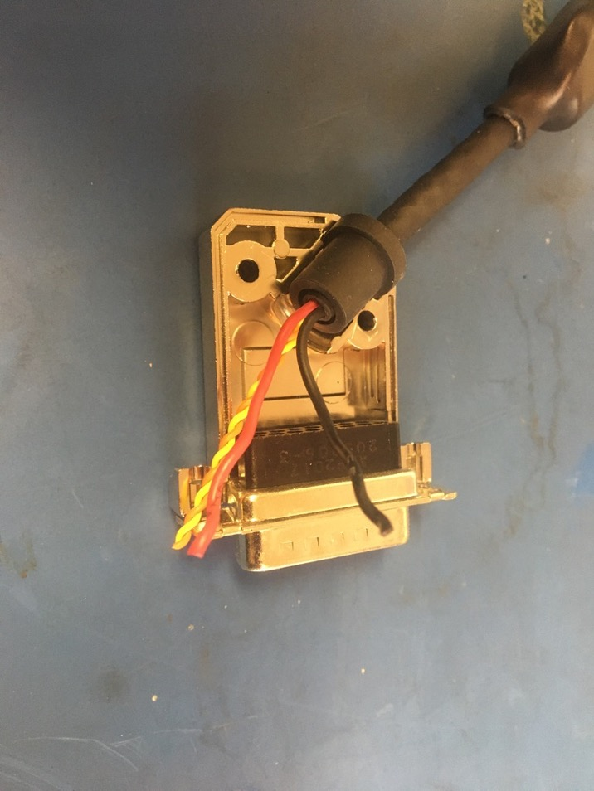
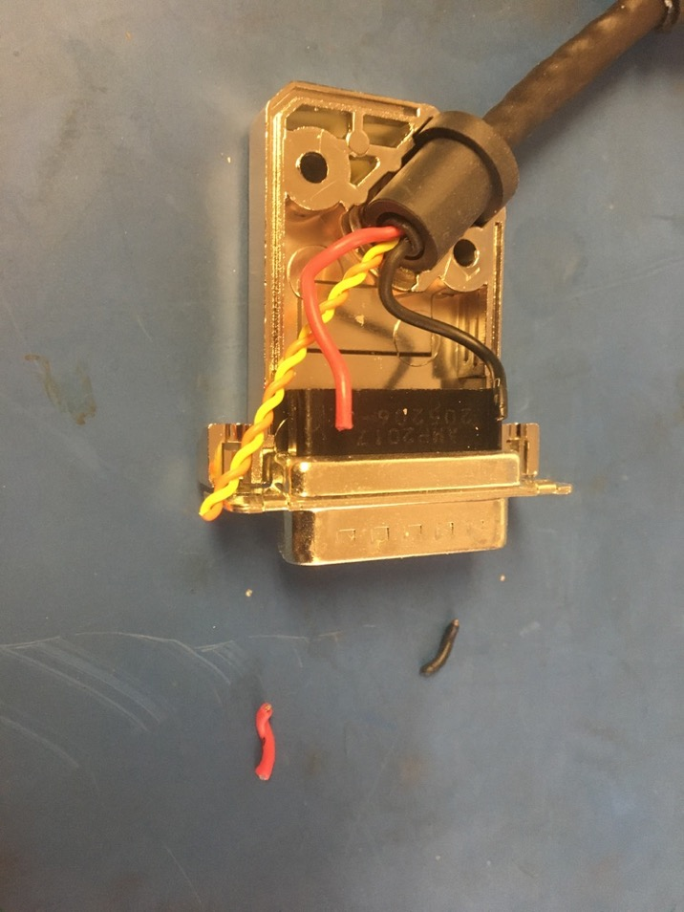
Untwist and straighten the red and black twisted pair. Position them as shown on the right and trim them so they end midway through the black part of the connector.

Slide 37


Strip about 2mm off the black wire. The D-sub crimper will be used for all the upcoming crimping though be sure to use the appropriate setting for the wire size. For the black and red wire, use the 20-24 awg setting.

Slide 38

Crimp on a 20-24 D-sub pin onto the black wire. It should be crimped such that the isolation is held by the first grip but not the second. A bit of exposed wire should also be peaking out of the top of the second grip.
Exposed wire just visible
Isolation in first grip

Slide 39


Insert the the black wire using the red end of the D-sub insertion/extraction tool. The pin should feel to click once inserted all the way. Please reference the accompanying pin out document to see where each wire should go.

Slide 40


Measure out and cut 1in of 28 awg red wire. Strip about 2mm off each end.

Slide 41


Strip the 20 awg red wire. Then crimp both red wires together using the a 20-24 awg D-sub pin. Crimp the other end of the 28 awg wire using a 24-28 awg sized pin and crimper setting.

Slide 42


Place both red wires into their holes simultaneously (its more difficult to do them one by one). Insert the wires fully one at a time using the insertion tool.

Slide 43


Untwist and straighten the orange and yellow twisted pair. Position them as shown in the photo on the right and trim them so they end midway through the black part of the connector.

Slide 44

Strip, crimp, and insert the orange and yellow wires as previously exampled by the black wire. Be sure to use 24-28 awg pins and crimper setting.

Slide 45


Now take the ground wire end of the harness and repeat the process of untwisting, measuring, trimming, stripping, crimping, and inserting the wires. Note that this end does not have a 28 awg red wire and that the orange and yellow wires are not in the same positions in the connector.

Slide 46

Place the tops of the D-sub shells onto the bottoms on each end. Put the connector screws and washers in as well.

Slide 47


Close each D-sub shell using the screws and nuts.

Slide 48

Wire harness complete! The ground wire will be given a tip later.

